Slide 1
Energy Evolution: an Examination of Consumption Habits and Socioeconomic Correlations
Mariangel Mora, Betty Paniagua, Chris Onubogu & Chris Roy

Slide 2
Hypothesis: Since the start of the 20th century, have the energy consumption habits of the world’s most populous countries changed? Is there a correlation between energy consumption and other key socioeconomic factors, such as gross domestic product and population?
Questions:
Does a country’s energy consumption per capita trend in accordance with its GDP per capita?
Does a country’s fossil fuel consumption have a statistically significant correlation to its GDP?
Do a country’s year-over-year changes in total energy consumption trend in-line with its increases/ decreases in population?
How do greenhouse gas emissions compare to renewable energy consumption
Hypothesis & Questions

Slide 3
Dataset: The dataset used for our analysis was sourced from Kaggle
World Energy Consumption
Data ethics and bias considerations:
The data is derived from multiple sources, and the dataset has been updated as new data has become available.
In an attempt to have a tenable scope for the project and avoid bias as much as possible, we decided to limit our analysis to the world's 25 most populous countries.
The population data is an aggregation based on information collected by the U.N.
The types of energy a country consumed, in what year consumption of that energy began, annual gross domestic product, and geographic location had no bearing on the determination of a country's inclusion in the project.
Further, from a data ethics standpoint, the World Energy Consumption dataset was selected because it is comprised of publicly available data, and the code used to ingest + process the data is provided by the authors. This combination ensures that users of the dataset have full visibility into how the data is being handled from beginning to end.
Dataset Selection, Ethics, & Bias Consideration

Slide 4
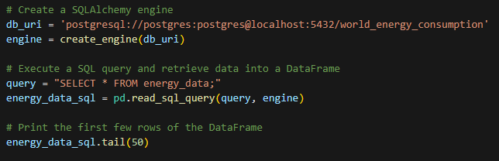
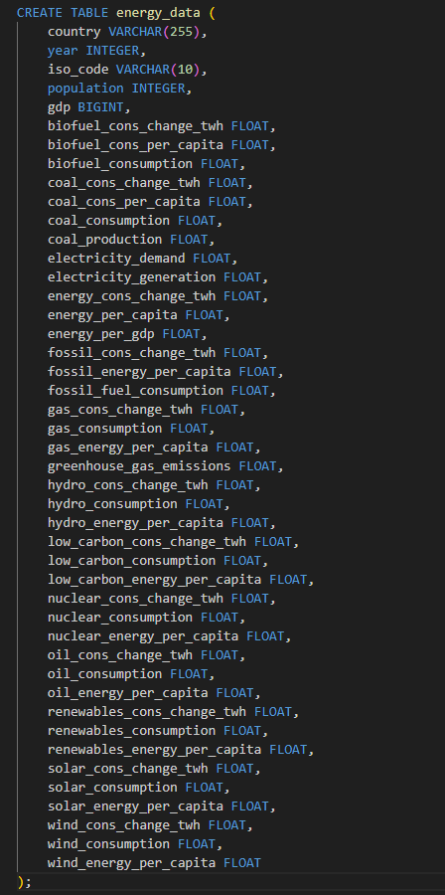
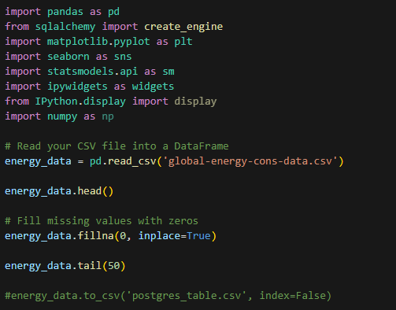
Github Repo
Data Ingestion process:
The data that powers our analysis is housed within a PostgreSQL database that can be hosted locally
The ‘global-energy-cons-data.csv’ file located in the repo is an abridged version of the larger dataset
The primary .ipynb file within the repo reads in the CSV and performs necessary data hygiene functions, and then writes the updated dataset to the ‘postgres_table.csv file
The ‘energy_data_schema.sql’ file within the repo contains the SQL code needed to create a table within your PostgreSQL database to store the data
The ‘postgres_table.csv’ file can be used to populate the table once it is created
Once the PostgreSQL database is configured, the primary ipynb file within the repo contains logic for reading the database via SQLAlchemy
ETL Process Overview

Slide 5
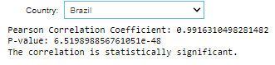
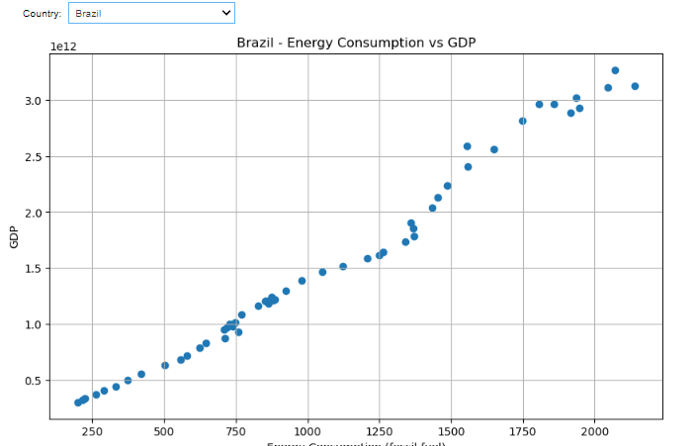
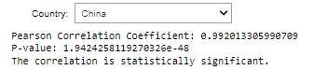
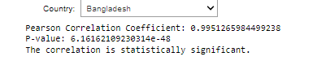
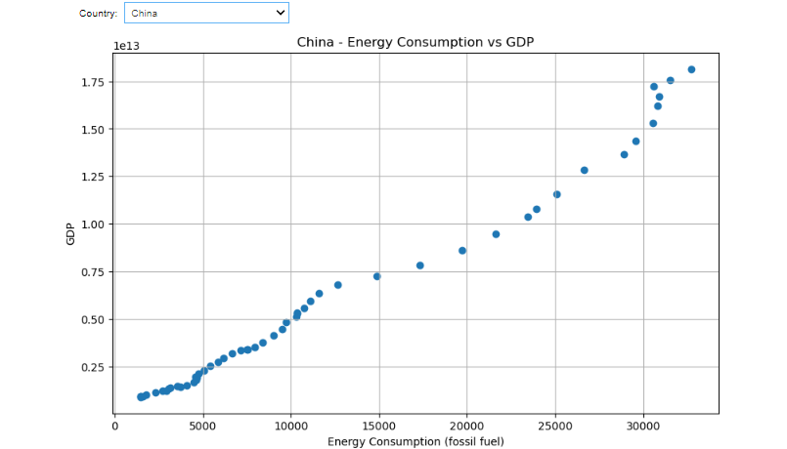
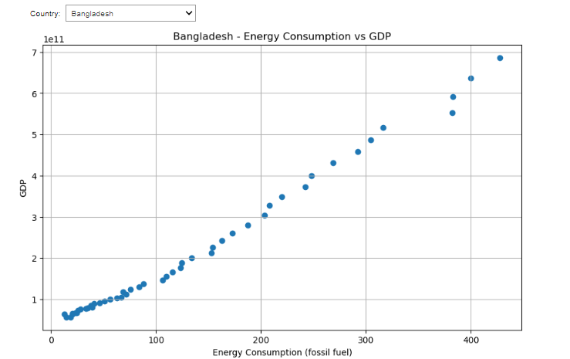
GDP stands for Gross domestic product which is often used to measure a country’s economic health.
We calculated the Pearson correlation coefficient to gauge the strength and direction of the linear relationship between energy consumption and GDP. A positive correlation indicates that as energy consumption rises, GDP typically increases as well, while a negative correlation would suggest the opposite effect. Among the countries studied, approximately two-thirds exhibit a direct correlation, showcasing that higher GDP tends to align with higher energy consumption.
Results:
Analysis: Energy Consumption vs GDP

Slide 6
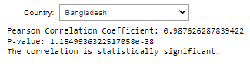
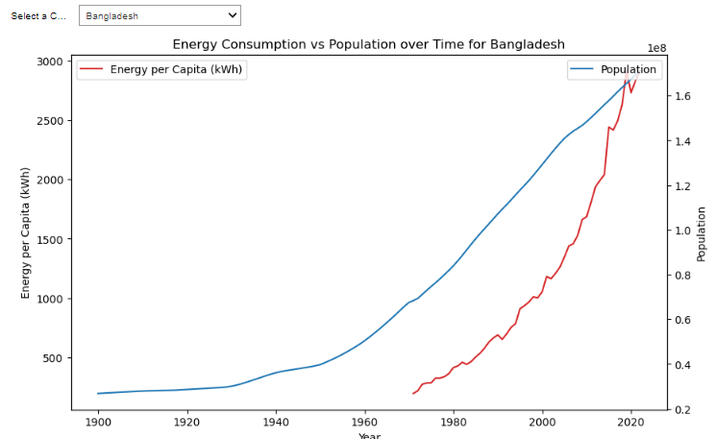
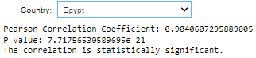
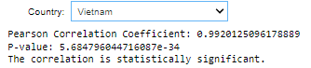
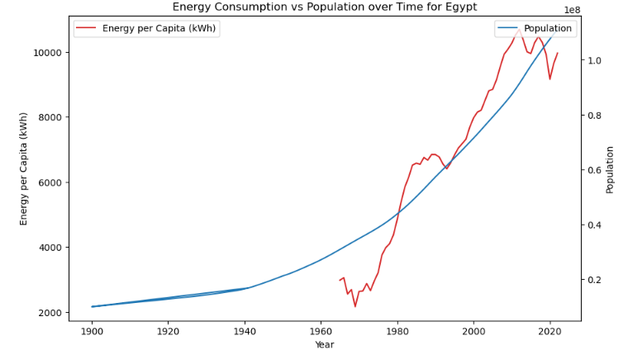
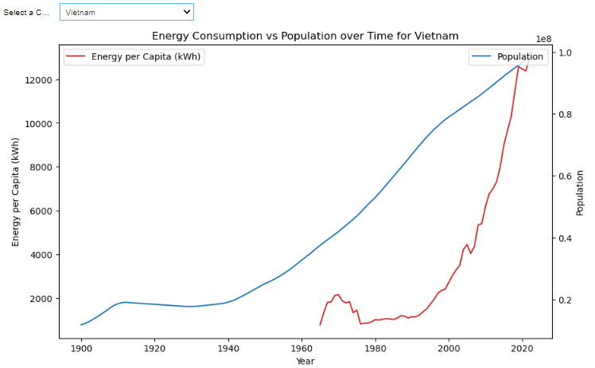
Analysis: Energy Consumption vs Population
Does a country’s energy consumption trend in accordance with its population i.e. as population increases, does energy consumption increase?
We analyzed data on energy consumption and population from multiple countries and visualized with an interactive line graph comparing energy consumption with population. The graph demonstrates a direct correlation between these two variables. The coefficient value indicates a very strong positive correlation between energy consumption and population. This suggests that as energy consumption increases, population tends to increase as well.
Results:

Slide 7

Overall, these findings highlight the connection between energy consumption, economic health, and population growth. The positive correlations suggest that policies and strategies aimed at promoting sustainable energy use and economic development can also have implications for population dynamics. Understanding and managing these relationships can be crucial for shaping effective policies and plans for sustainable development and growth.

Slide 8
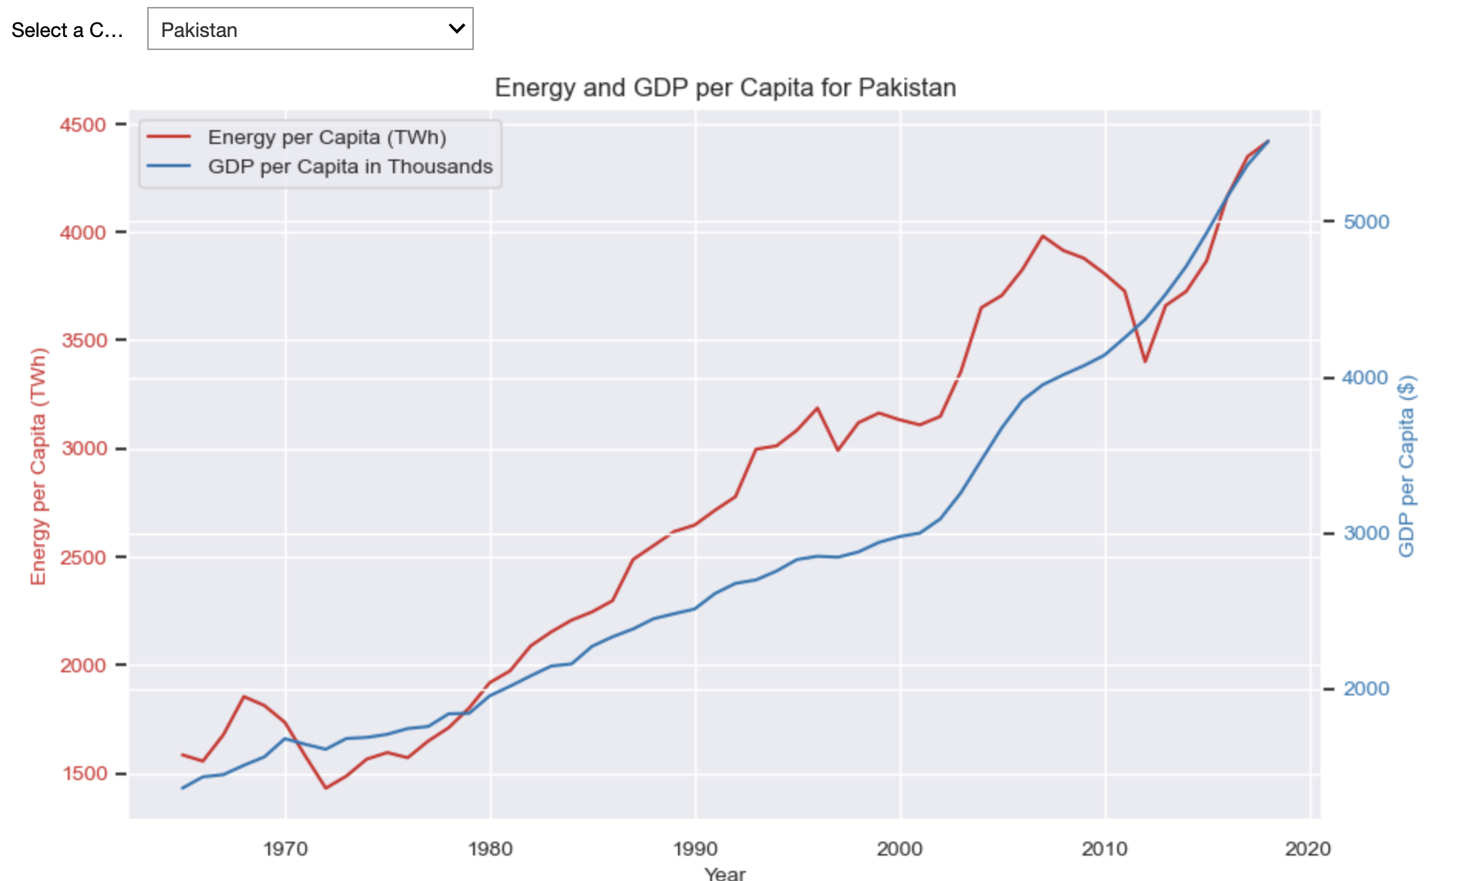
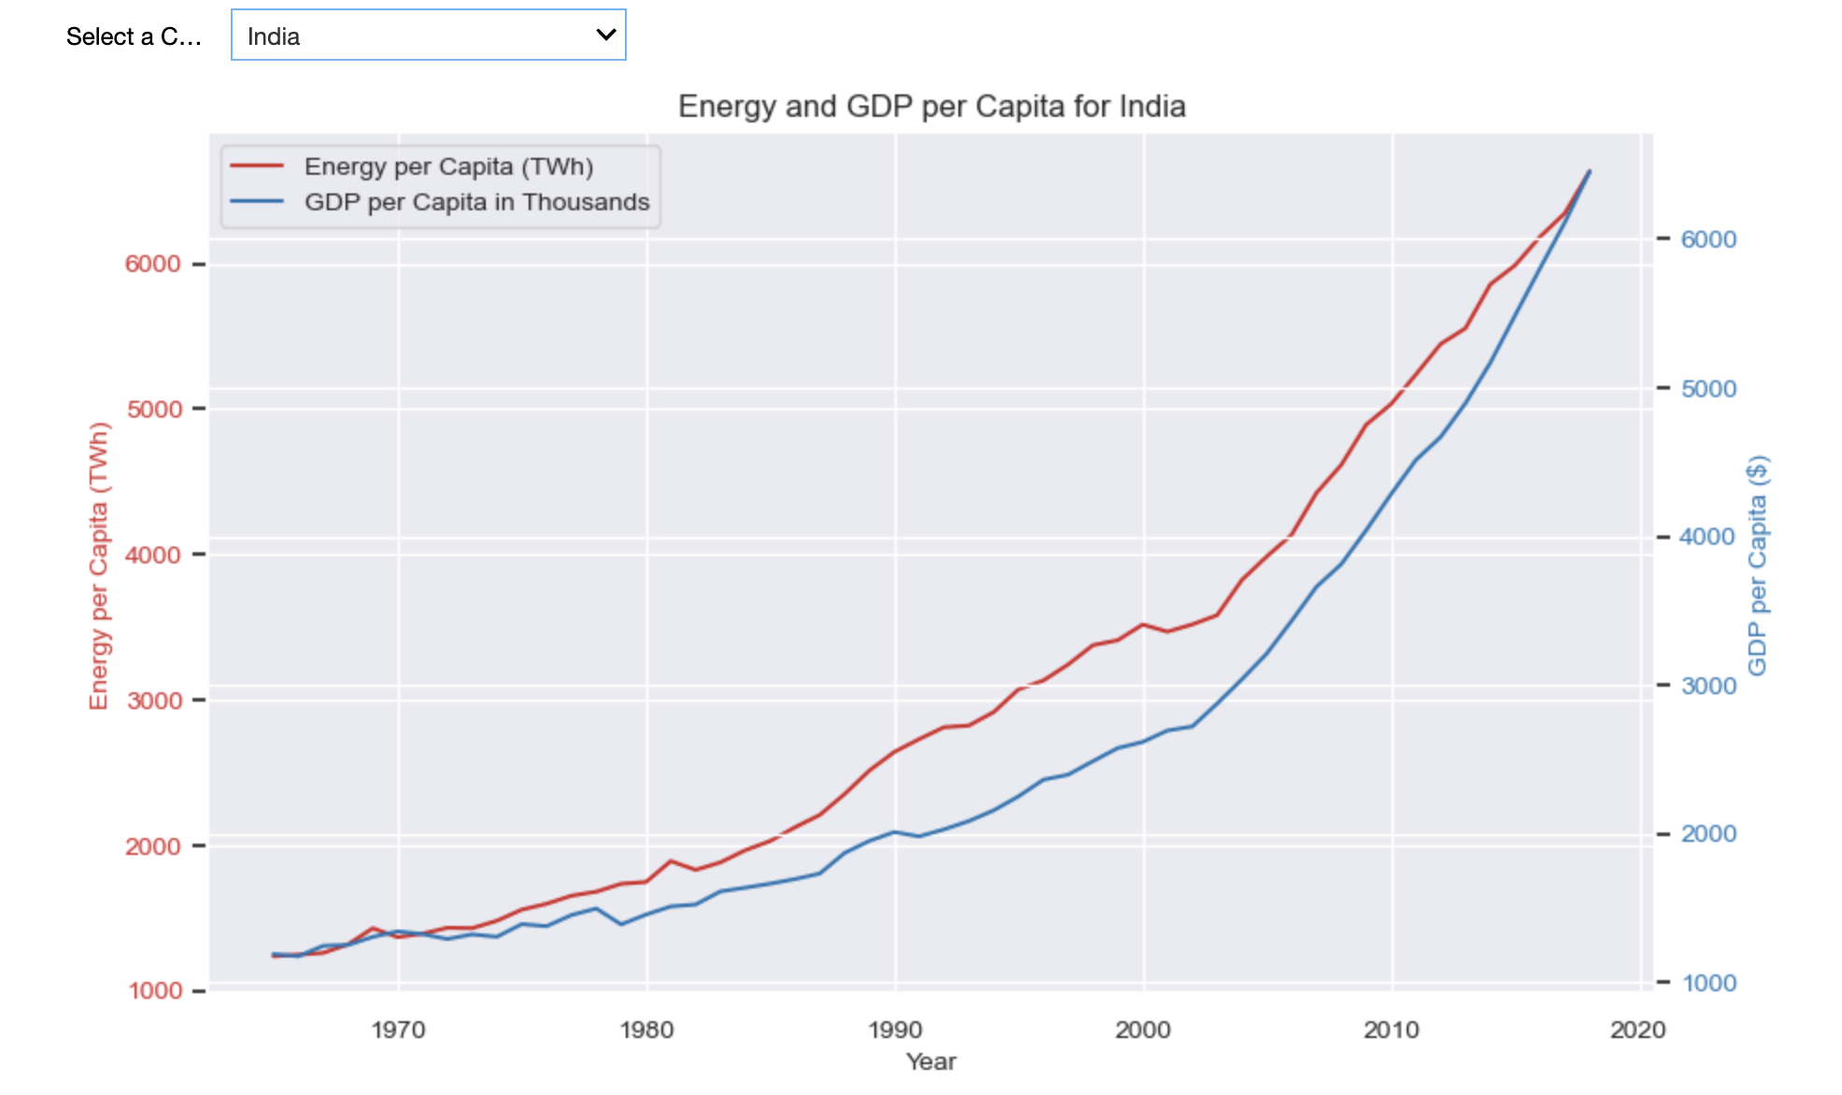
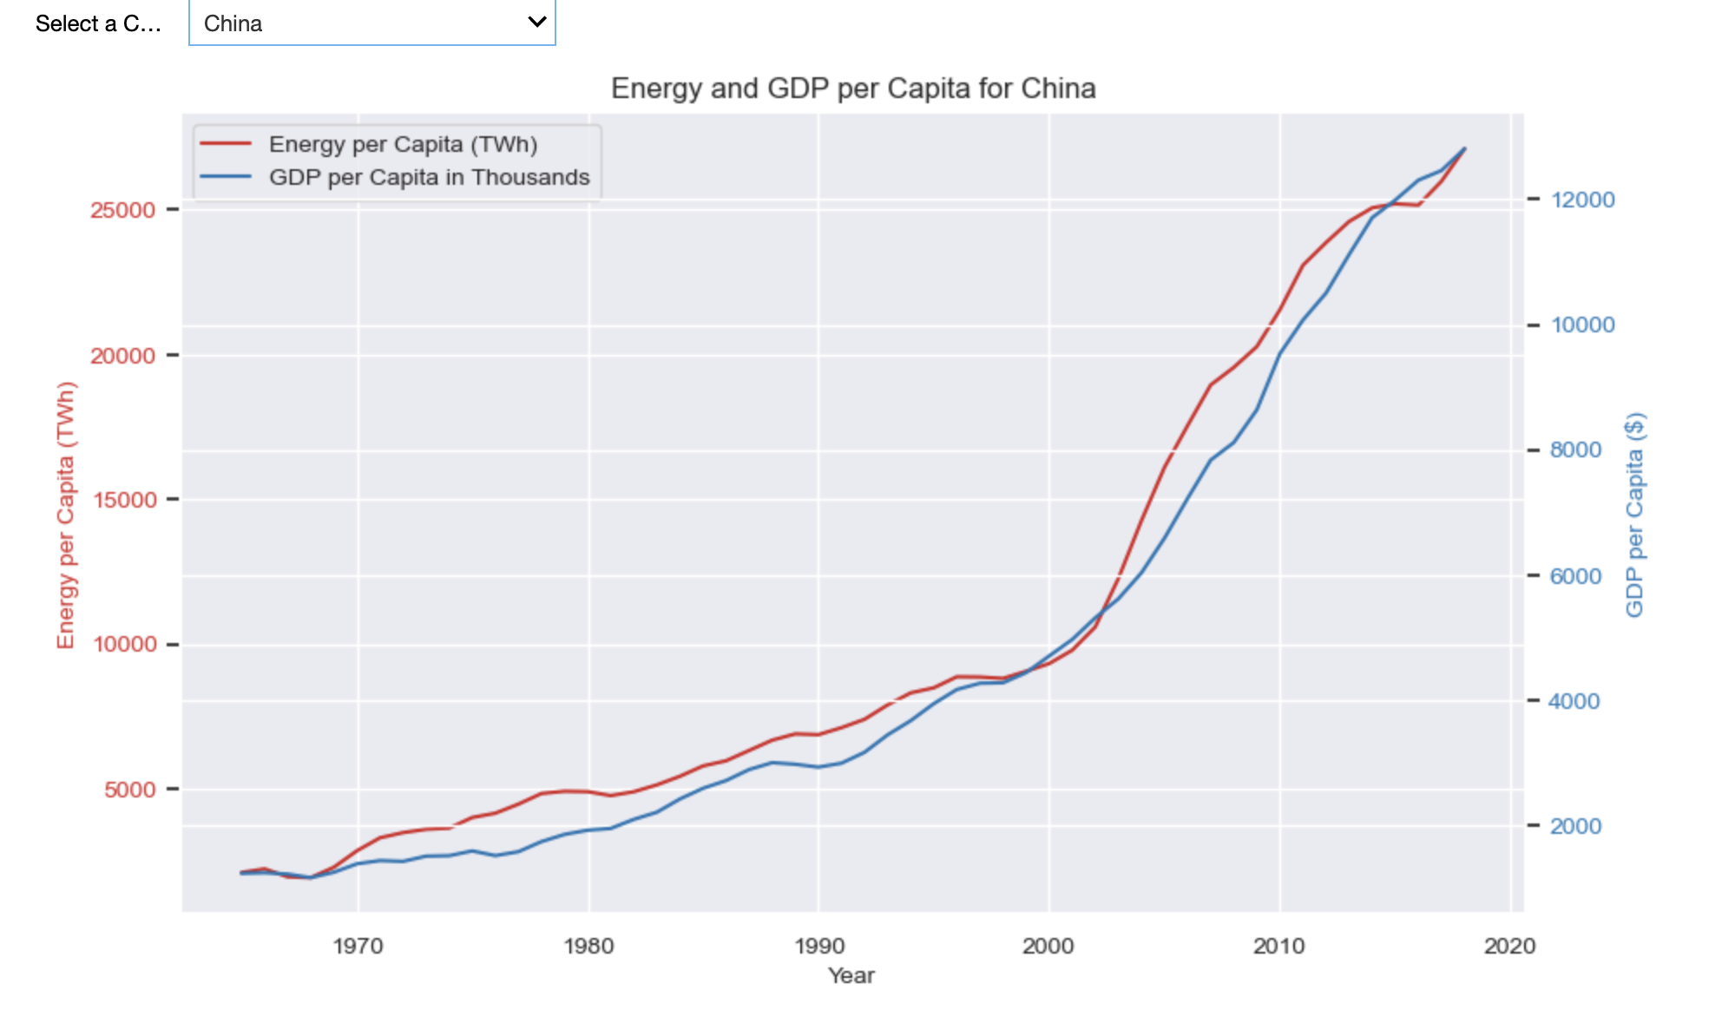
Gross Domestic Product (GDP) it's widely used to evaluate a nation's economic well-being. Historically, as economies grow, so does their electricity consumption due to increased production and population. Energy plays a crucial role in the transformation of natural resources into goods and services, thus linking energy use per person with GDP per person.
Analysis: Energy per capita & GDP per capita

Slide 9
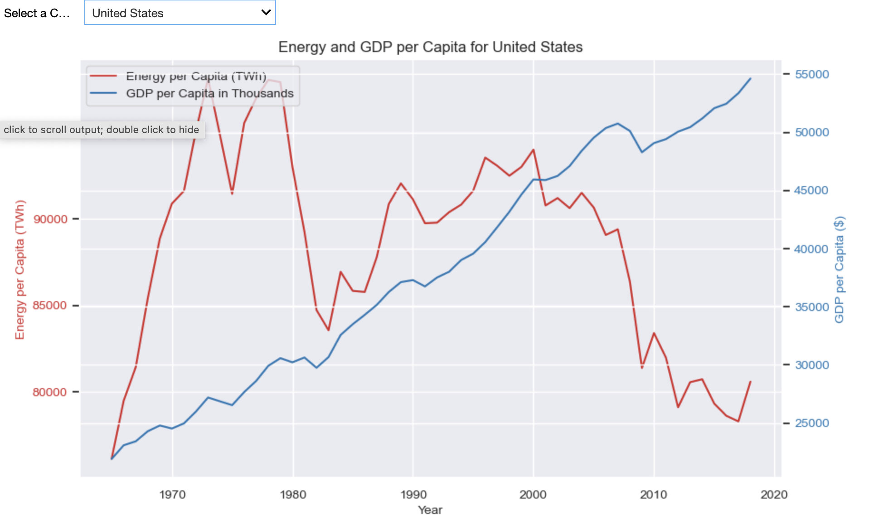
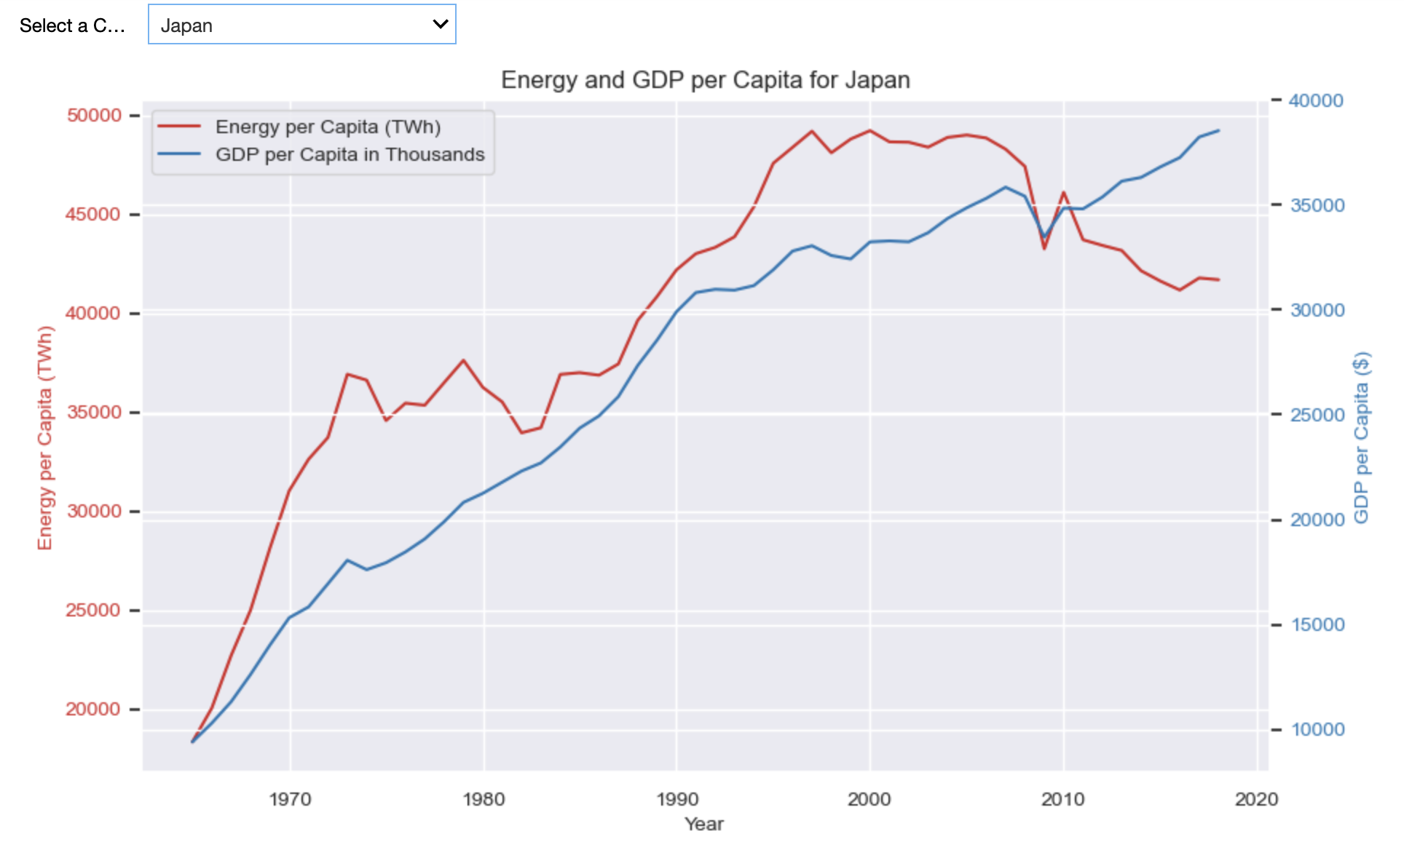
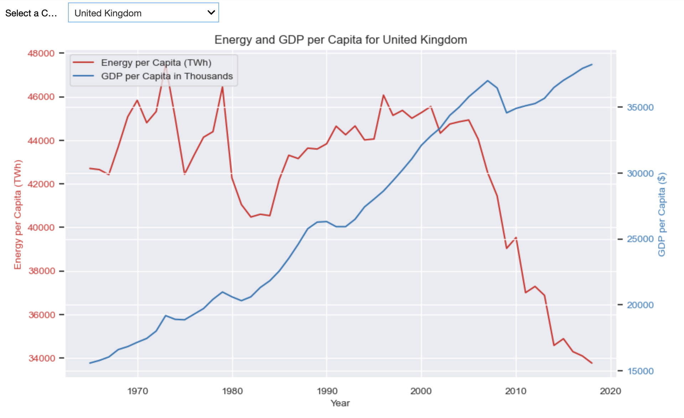
One significant factor that contributes is advancement of technology and improvements in energy efficiency. These countries have invested in technologies and practices that enable them to produce more goods and services while using less energy per unit. Additionally, shifts in their economies towards less energy-intensive sectors such as services and information technology also contribute to the decline in energy consumption per capita.
Analysis: Energy per capita & GDP per capita cont.
Source: https://www.eia.gov/energyexplained/use-of-energy/

Slide 10
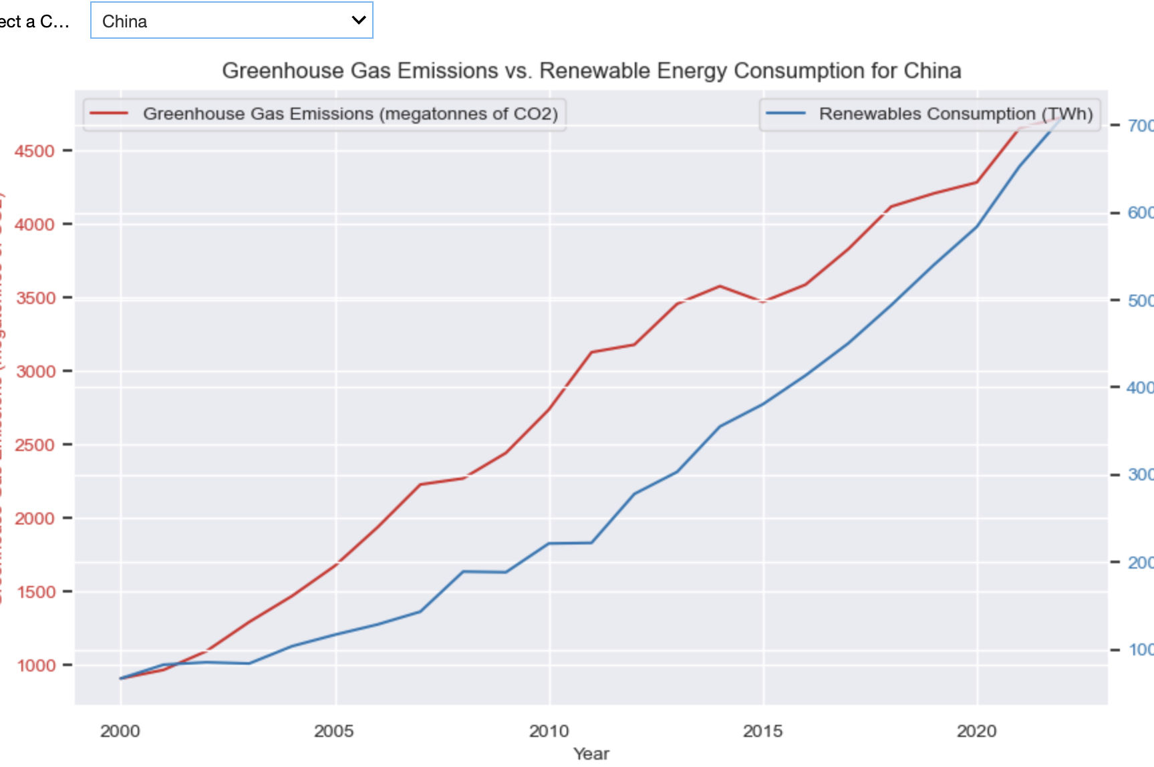
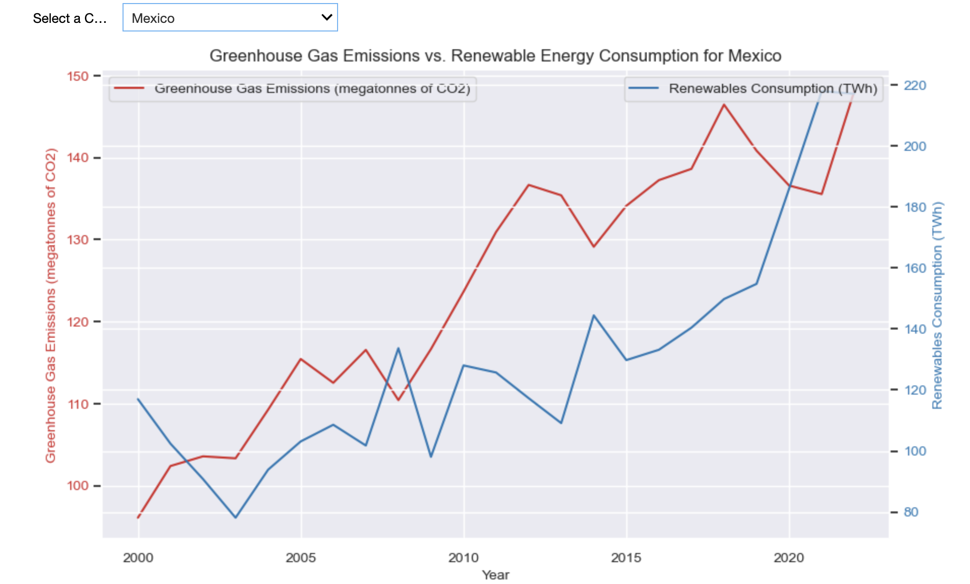
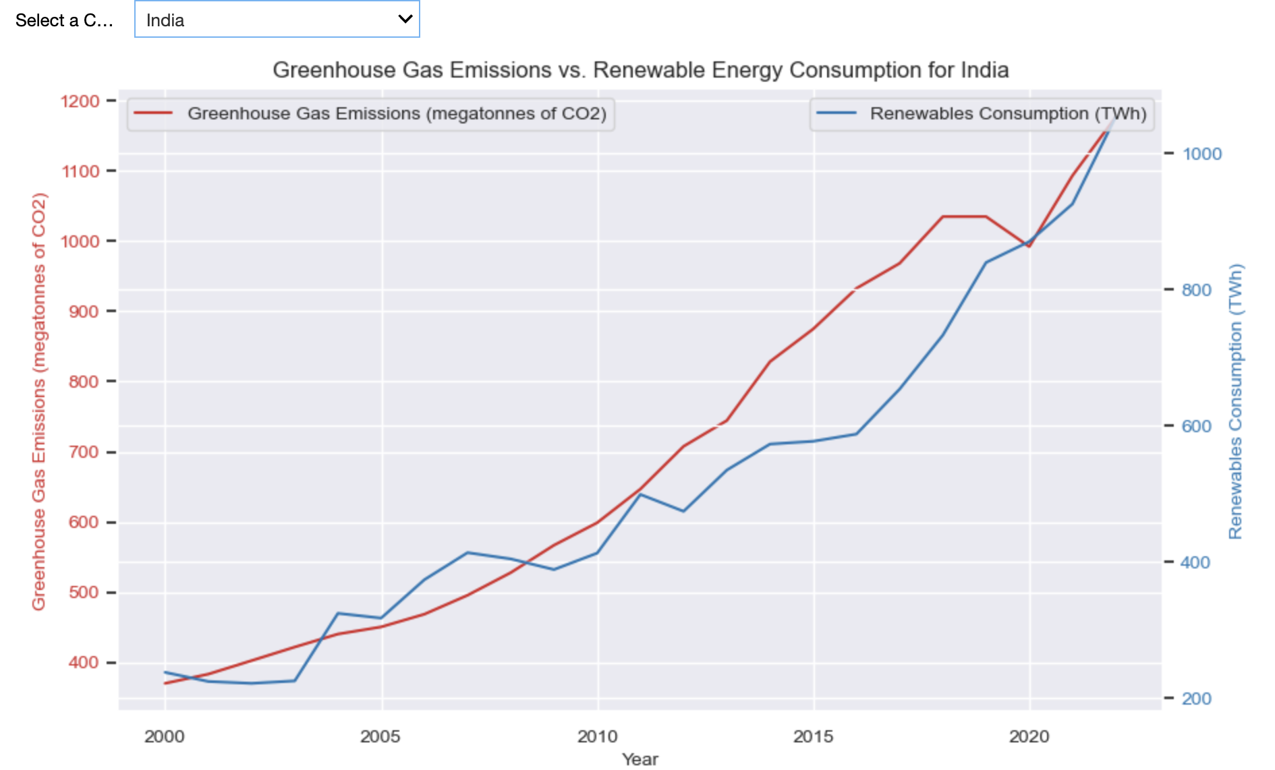
Greenhouse gas emissions, primarily carbon dioxide (CO2) contribute to global warming and climate change by trapping heat in the Earth's atmosphere. Human activities, such as burning fossil fuels for energy, industrial processes, and deforestation, are the primary drivers behind these emissions.
On the other hand, renewable energy consumption involves harnessing energy from naturally replenishing sources such as sunlight, wind, and water. Unlike fossil fuels, renewable energy sources produce little to no greenhouse gas emissions during energy generation, making them a crucial component of efforts to mitigate climate change.
Analysis: Greenhouse Emissions & Renewable Energy Consumption

Slide 11
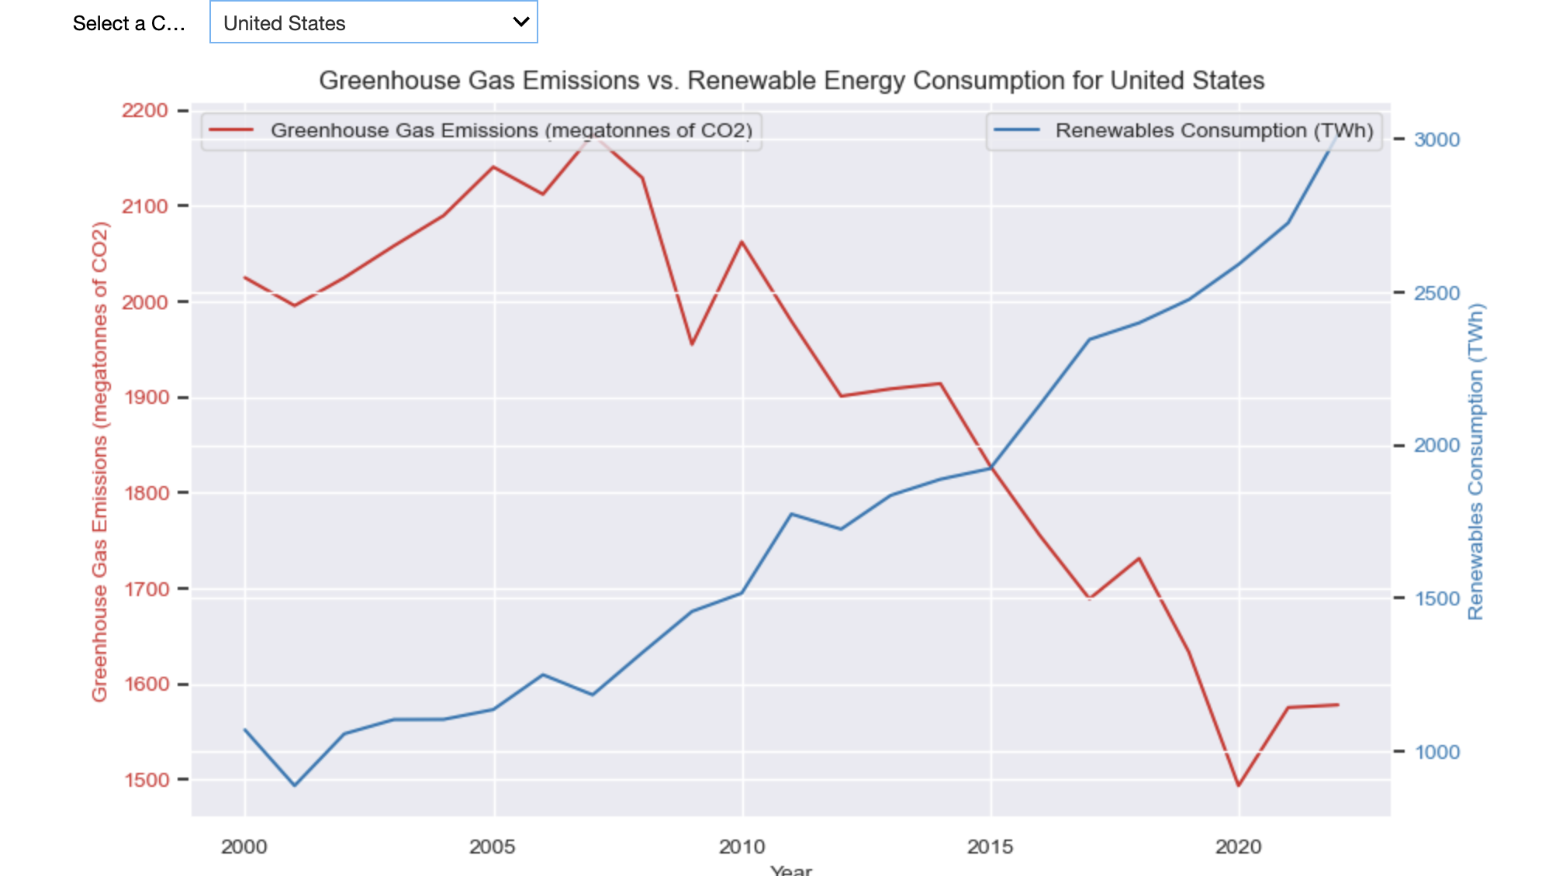
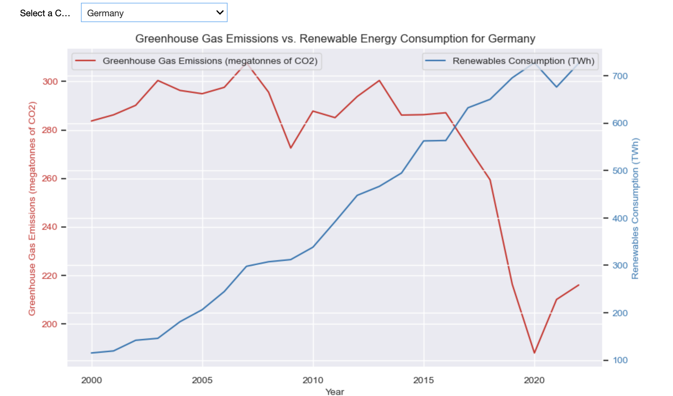
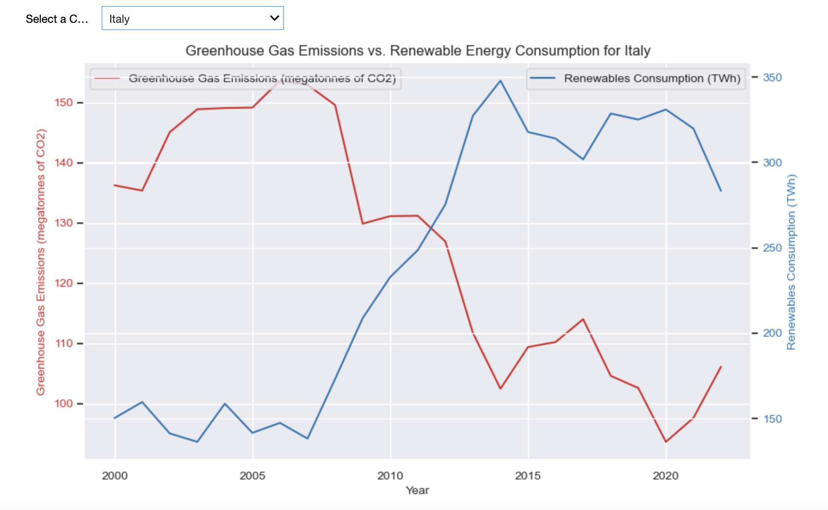
Whereas a trend has been noticed in developed countries such as the United States, Germany, and Italy with reduced levels of greenhouse gasses due to strict environmental regulations, emission reduction targets, and renewable energy incentives. Developed nations' access to advanced renewable technologies facilitates the transition to cleaner energy sources, allowing them to meet energy demand while cutting emissions. Significant commitments to greenhouse gas reduction under international agreements like the Paris Agreement further drive the shift to renewables and lessen reliance on fossil fuels.
Analysis: Greenhouse Emissions & Renewable Energy Consumption cont.
Source : https://science.nasa.gov/climate-change/causes/
https://www.un.org/en/climatechange/raising-ambition/renewable-energy/

Slide 12
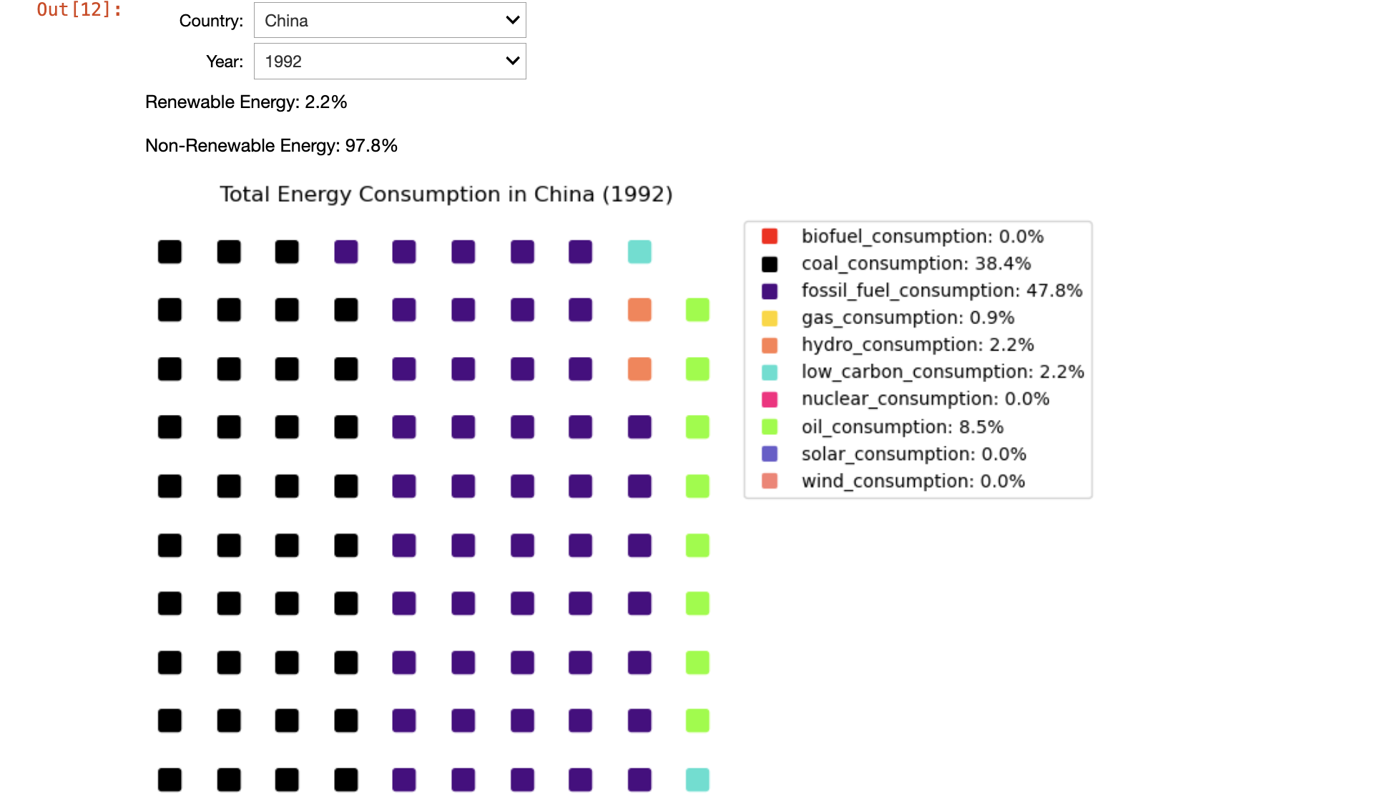
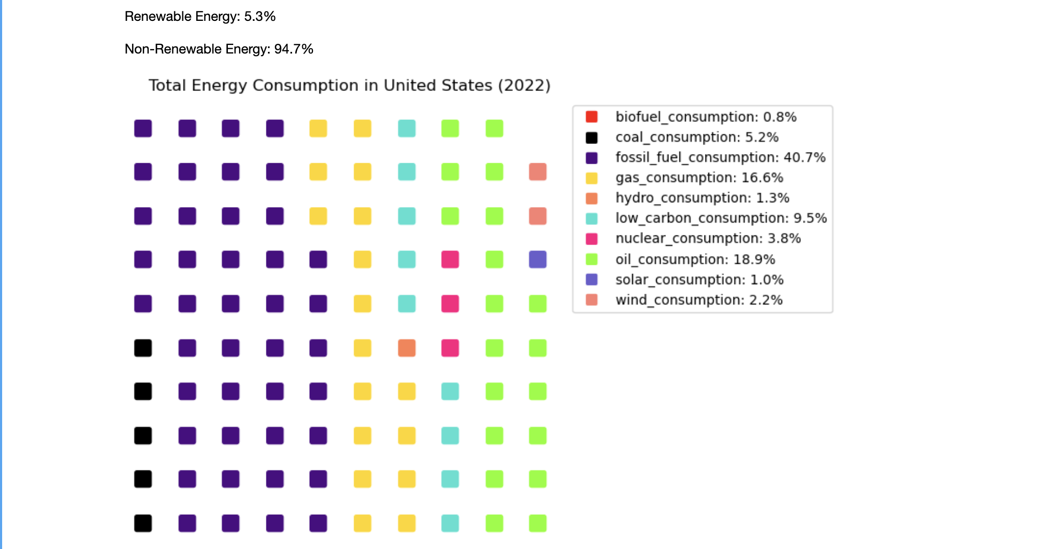
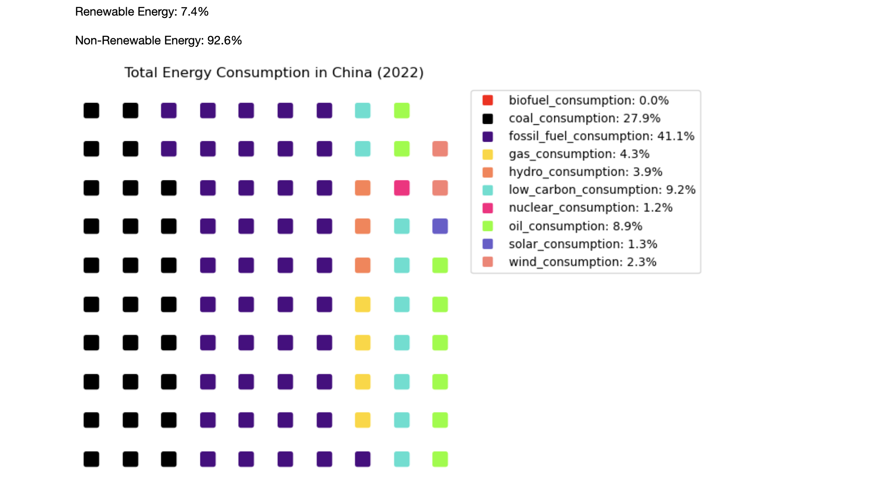
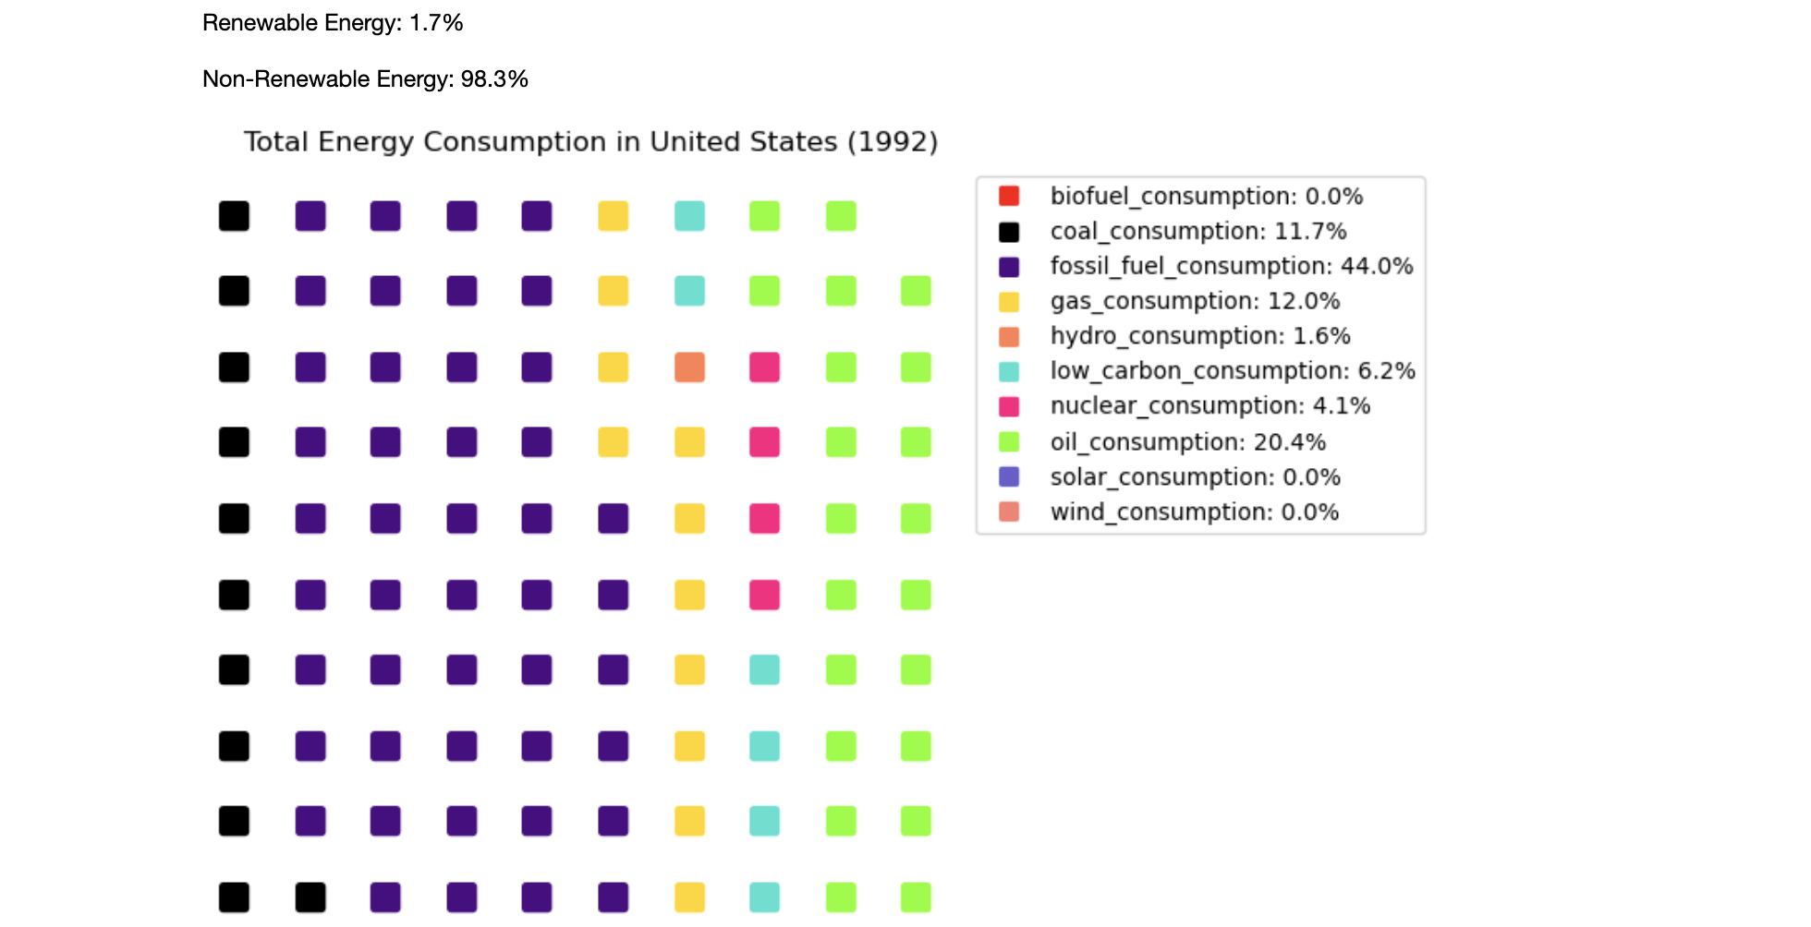
Renewable v Non-Renewable Energy Sources: Breakdown by Country
Source : https://science.nasa.gov/climate-change/causes/
https://www.un.org/en/climatechange/raising-ambition/renewable-energy/

Slide 13
Renewable v Non-Renewable Energy Sources: Breakdown by Country
Based on the data available, one can observe that between 1992 and 2022, there has been an uptick towards the adoption of renewable energy sources (wind, hydro, solar and biofuel) by the vast majority of the most populous nations in the world.
However, it is equally undeniable that this is a gradual increase, and all but 2 countries for whom data is available still consume > 80% of their energy from non-renewable energy sources.
If we want to make a real impact in efforts to fight climate change, there should be increased urgency to increase the rate of adoption of renewable energy sources especially in the most populous countries which are responsible for vast amounts of greenhouse gas emissions.
Source : https://science.nasa.gov/climate-change/causes/
https://www.un.org/en/climatechange/raising-ambition/renewable-energy/

Slide 14
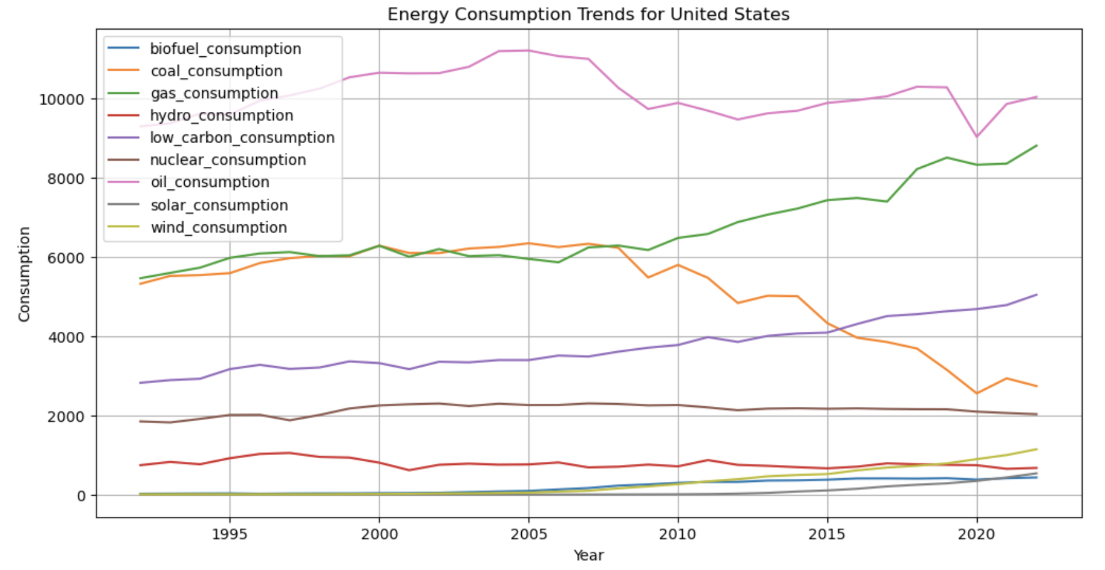
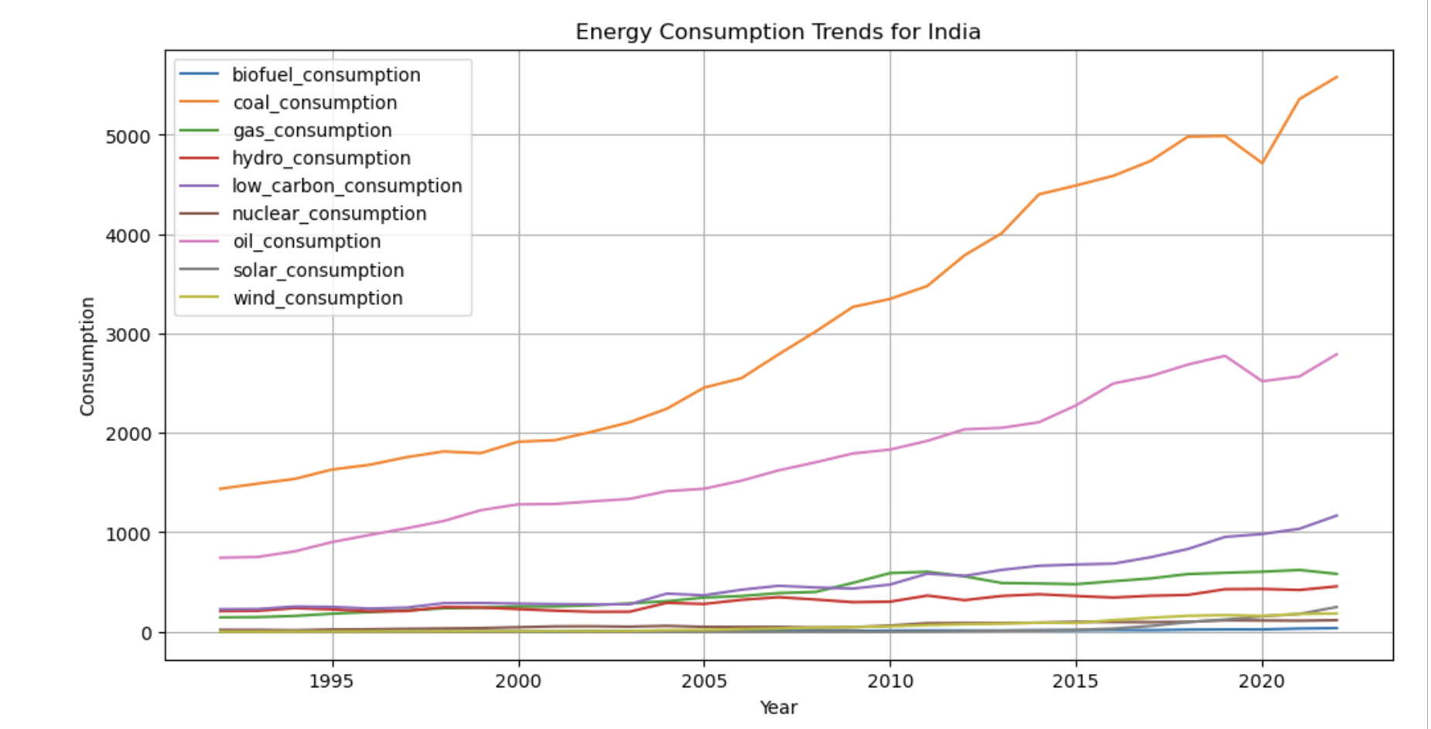
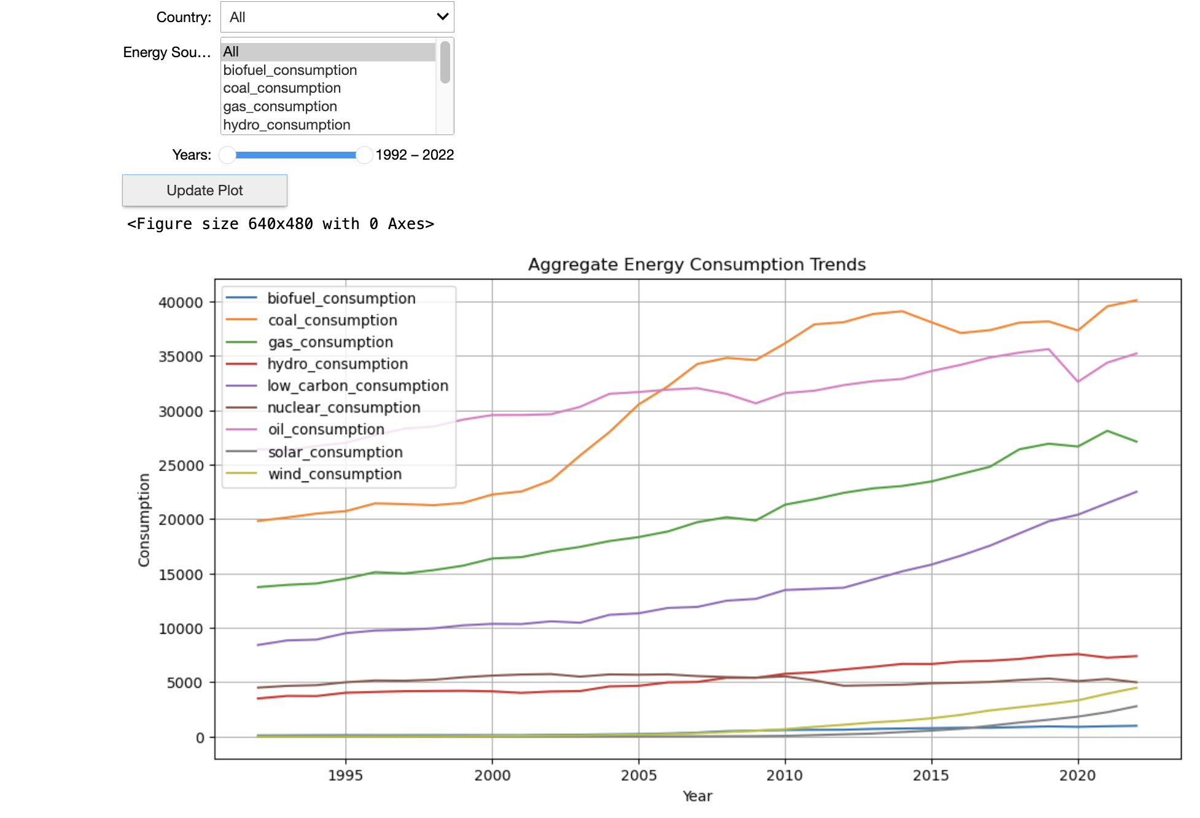
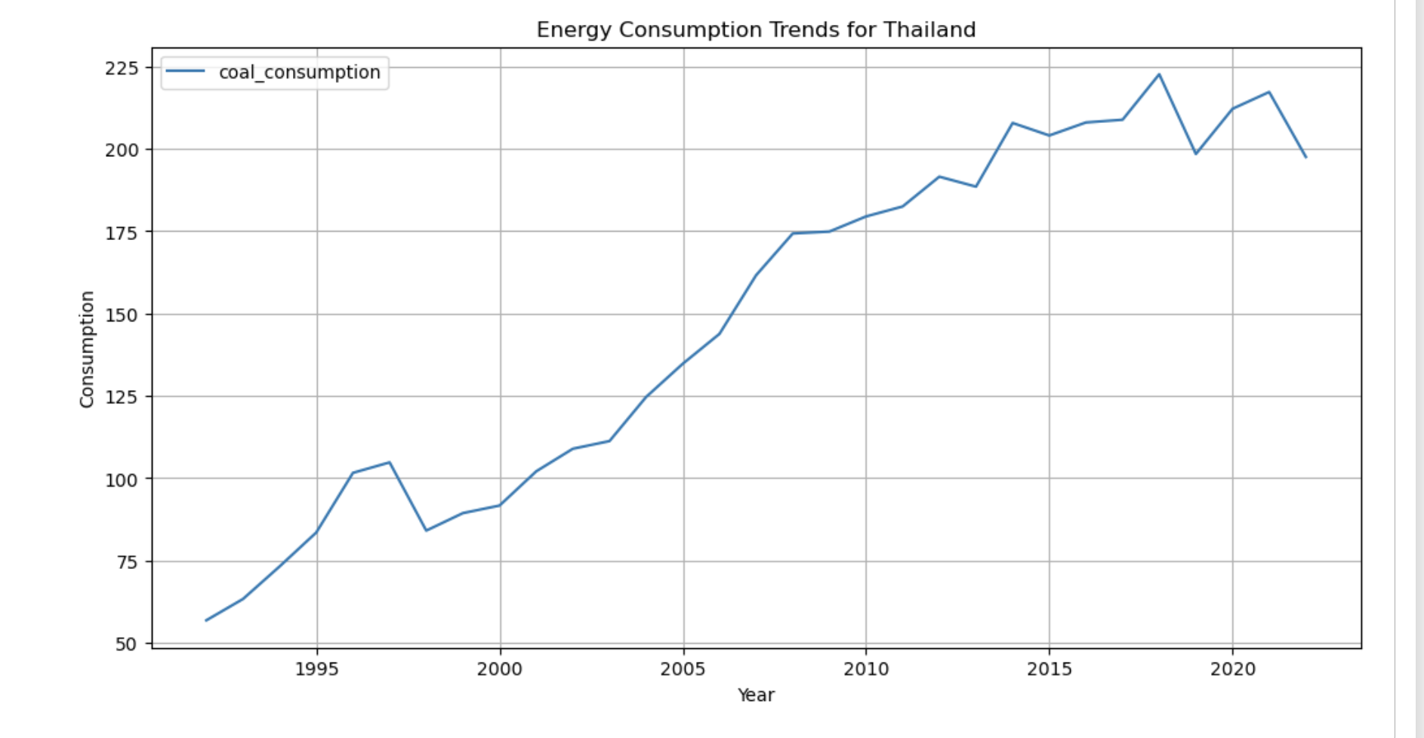
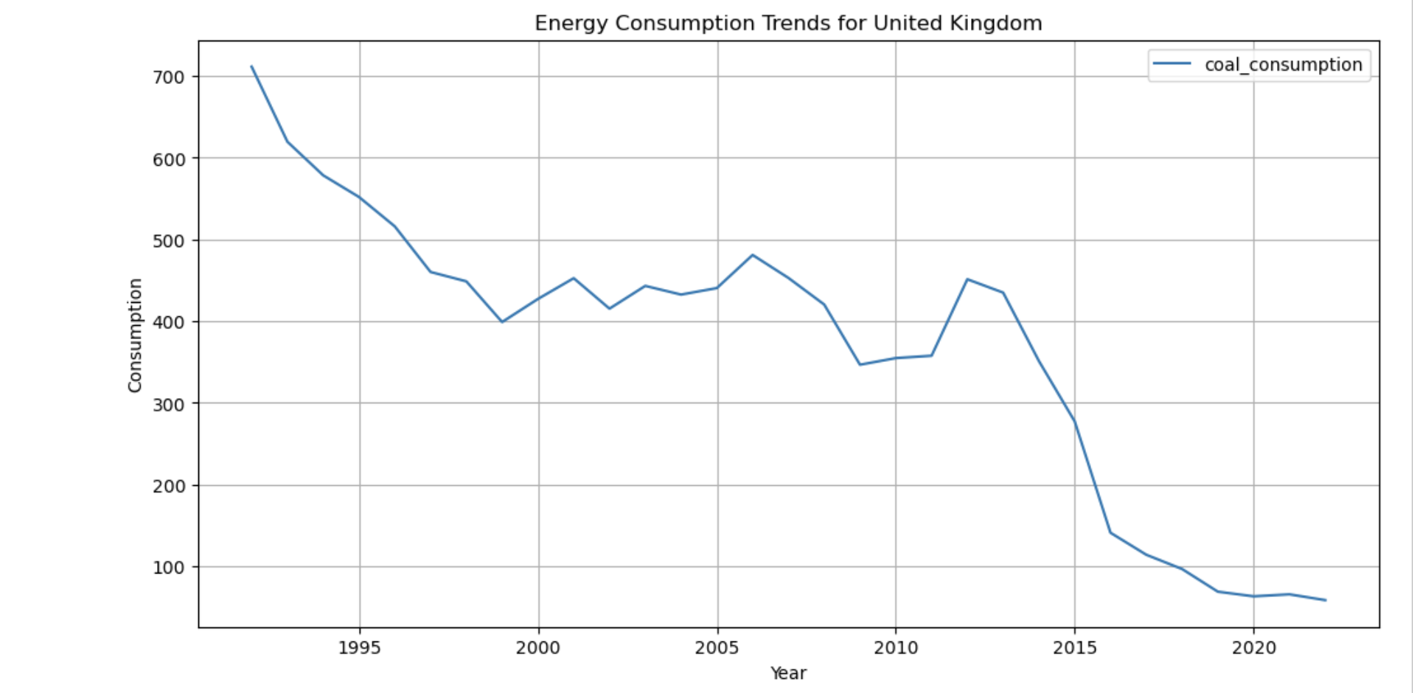
Energy Sources Trendline: Breakdown by Country

Slide 15
Energy Sources Trendline: Breakdown by Country
Taking a look at the at the trendline for energy sources when broken down by country, we more or less confirm our observations from the previous slides.
The most populous nations still consume an overwhelming amount of their energy from non-renewable sources; primarily oil, coal, and gas.
There is a decline in the use of certain sources such as coal from what might be considered the most technologically advanced nations (US, UK, Germany, etc) but even in decline, their overall consumption numbers mirror those countries who are trending upwards in their consumption of these ‘undesirable’ sources.
Source : https://science.nasa.gov/climate-change/causes/
https://www.un.org/en/climatechange/raising-ambition/renewable-energy/

Slide 16
Summary
A higher GDP tends to be strongly correlated with higher energy consumption
A higher population tends to be strongly correlated with higher energy consumption
GDP per-capita and energy consumption per-capita tend to be correlated, however, whether the correlation is positive or negative largely depends of the country developing stage as countries with a developing economy tend to have an increased demand for energy to power manufacturing, infrastructure, and urban growth.
Countries that are more invested in developing/ leveraging green technologies and that participate in global environmental accords tend to seeing their greenhouse gas emissions decrease as their renewable consumption increases
The energy consumption from renewable sources is on the rise among the top 25 most populous nations, but there is still a lot work to be done as he majority of consumption still occurs via non-renewable sources.

